Slide 1
Administering Windows 7
Lesson 11

Slide 2
Objectives
Troubleshoot Windows 7
Use remote access technologies
Troubleshoot installation and startup issues
Understand BranchCache
Use Backup and Restore program
Notes:
Outline the material you are going to cover in this lesson. Do not go into detail as each of these points will be expanded on in the lesson. You may also want to mention the Technology Skills that are being covered for the Certification exam also.

Slide 3
Troubleshooting
Primary function of a desktop technician.
Good troubleshooters are often intuitive.
In professional environments, it is good to have a standardized procedure.
Allows you to explain to the client, share your findings, and account for your time.
Notes:
Introduce troubleshooting.

Slide 4
Troubleshooting Procedure
Establish the symptoms
Identify the affected areas
Establish what has changed
Select the most probable cause
Implement a solution
Test the result
Document the solution
Notes:
Explain the troubleshooting procedure, perhaps using an actual example.

Slide 5
Using Troubleshooting Tools
Troubleshooting requires the right tools and the ability to use them properly.
We have discussed many tools in this course that can and will be used to troubleshoot. See table 11-1 for a complete list of all the tools discussed to date in class.
More tools specifically for troubleshooting:
  Remote Assistance and Remote Desktop
  Windows RE — System Recovery Tools
Notes:
Discuss some of the tools that can be used for troubleshooting from Table 11-1 in the text book.

Slide 6
Using Remote Access Technologies
Microsoft Management Console
  Redirecting a snap-in/creating a remote console
Remote Assistance
Remote Desktop
Windows Remote Management
Notes:
Introduce the concept of REMOTE access and troubleshooting and its advantages. Briefly introduce each tool as they will be discussed in detail in the next slides.

Slide 7
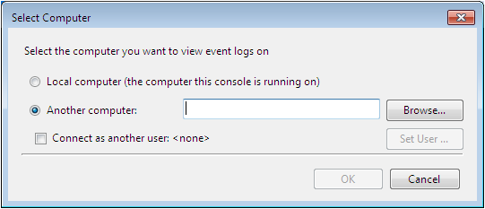
Using Microsoft Management Console (MMC)
Redirecting a Snap-In
Creating a Remote Console
Notes:
Explain the concepts of Redirecting a Snap-in and Creating a Remote Console. Demonstrate with a custom MMC, if possible.

Slide 8
Using Remote Assistance
Enables a person at one location to connect to a computer at another location, to view, chat with, or completely take control of the system:
  Technical support
  Troubleshooting
  Training

Slide 9
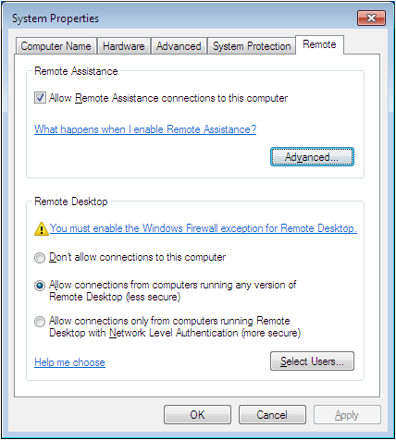
Configure Remote Assistance
Notes:
Discuss the options on the System Properties dialog box that pertain to Remote Assistance.

Slide 10
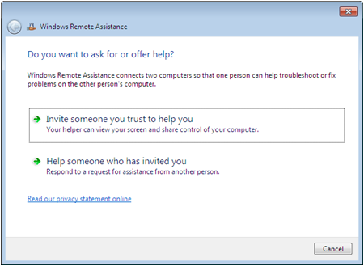
Creating an Invitation
Client must issue an invitation and send it to an expert
Can be sent via email or saved to a file and sent using alternate method
Notes:
Explain the concept of creating an invitation.

Slide 11
Securing Remote Assistance
Because of the potential damage that could be done by the wrong assistant, there are many protective features built in:
  Invitations
  Interactive connectivity
  Client-side control
  Remote control configuration
  Firewalls
Notes:
Describe the protective features built in to remote assistance.

Slide 12
Remote Desktop
Administrative feature enabling users to access computers from remote locations with no interaction required from the remote site
When connected, it is just like sitting in front of the computer
Usually used for administrators to connect to servers that are not easily accessible
Uses an implementation of Remote Desktop Services from Windows Server
Notes:
Explain that although you must purchase licenses for a server to host a large number of clients running Remote Desktop Service, Windows 7 allows a single remote desktop connection for administrative purposes, without the need for a separate license.

Slide 13
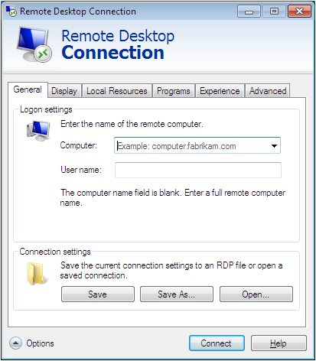
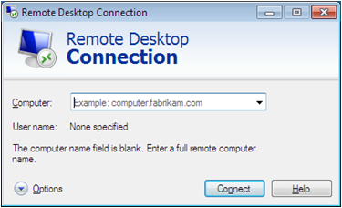
Using the Remote Desktop Connection Client
Used to connect to
the remote computer
Notes:
Describe some of the settings in Remote Desktop Connection Client.

Slide 14
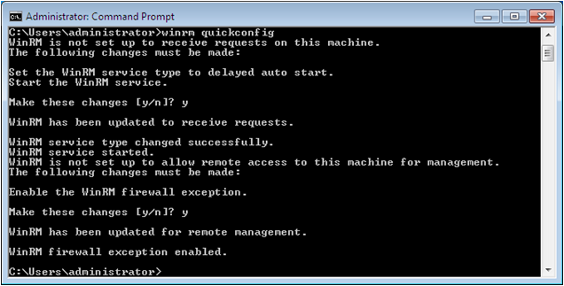
Using Windows Remote Management
Execute programs from the command line on remote computers without having to open a Remote Desktop session:
  Winrm quickconfig
Notes:
Introduce Windows Remote Management

Slide 15
Using WinRS.exe
Once Remote Management has been configured, you can execute commands on remote computers who have also been configured:
  winrs –r:computer [-u:user] [-p:password] command
Notes:
Explain the syntax of the winrs command.

Slide 16
PowerShell Remote Commands
Requires the Windows Remote Management service to be configured and running on both computers:
  icm computer {command}
Notes:
Introduce PowerShell Remote Commands and the syntax.

Slide 17
Understanding the Windows 7 Startup Process
The process is substantially different from those of Windows XP and other NT-based Windows versions:
  Power-on self–test (POST) phase
  Initial startup phase
  Windows Boot Manager phase – Reads BCD
  Windows Boot Loader phase
  Kernel loading phase
  Logon phase
Notes:
Note that the Windows Startup Process changed drastically with Windows Vista and is the same in Windows 7. There is a chart that can be referenced for users who have previous Windows Startup process knowledge.
Describe the Windows 7 Startup Process.

Slide 18
  Power-on self–test (POST) phase
When PC is turned on the either
  BIOS
  EFI
runs a hardware self-test procedure that
  Detects devices installed in the system
  configures them using settings stored in non-volatile memory
  After main POST any devices with there own BIOS will run it.

Slide 19
Initial startup phase
the system reads the BIOS settings to determine which hardware device it should use to boot the computer
from a hard disk, the system loads the master boot record (MBR) from the disk and locates the active (bootable) partition
The system then loads and runs a stub prograrm called Bootmgr, which switches the processor from real mode to protected mode and loads the Windows Boot Manager application.

Slide 20
Windows Boot Manager phase – Reads BCD
The system reads the Boot Configuration Data (BCD) registry file
  contains the systemt boot menu information
  Provides the user with access to the boot menu
If there is ony one operating system the boot menu can only be accessed by presssing a speicic key a startup.
If there are multiple operating systems the boot menu appears and shows the OS’s available

Slide 21
Windows Boot Loader phase
In this phase various operating system elements into memory including but not actually run.
  Windows kernel
  Hardware Abstraction Layer (HAL)
  system registry hive
    A hive is a logical group of keys, subkeys, and values in the registry that has a set of supporting files containing backups of its data.
  boot class device drivers

Slide 22
Kernel Load Phase
The system runs the Windows Executive (consisting of the Windows kernel and the HAL), which processes the registry hive and initializes the drivers and services specified there
starts the Session Manager, which loads the kernel-mode part of the Win32 subsystem, causing the system to switch from text mode to graphics mode

Slide 23
Kernel Load Phase
loads the user-mode porrion of win32, which provides applications with indirect, protected access to the system hardware
performs delayed rename operarions resulting from system updates that must replace files that were in use when the update was installed
creates additional virtual memory paging files and starts the Logon Manager

Slide 24
  Logon phase
) The system loads the
  Service Control Manager (SCM)
  the Local Securiry Authority (LSA)
Then presents the logon user interface (LogonUI)
The interface passes the credentials supplied by the user to the LSA for authentication

Slide 25
  Logon phase
the SCM loads the Plug and Play services and drivers that are configured for autoloading.
If the authentication is successful, the Logon Manager launches
  Userinit.exe, which is responsible for applying group policy settings and running the programs in the Startup group
  then loads the Windows Explorer shell, which provides the'Windows desktop

Slide 26
Troubleshooting Startup Failures
The first step is determining exactly where in the startup process the failure is occurring:
  POST failures
  Initial startup failures
  Driver and service failures
  Logon failures
Notes:
Describe how to use your knowledge of the startup process to help you troubleshoot problems that occur during the different phases – on next slides.

Slide 27
POST Failures
Is the problem software or hardware?
Failures during the POST are hardware failures.
Beep sequences will help you to determine the exact failure.

Slide 28
Initial Startup Failures
Typically a “Non-system disk or disk error”
Errors before progress bar appears are usually:
  Incorrect BIOS settings
  Hardware faults
  Missing startup files
  Data corruption
Use recovery tools to fix or replace hardware component

Slide 29
Driver and Service Failures
The appearance of the progress bar indicates that the kernel has loaded successfully.
Problem occurring here is usually an issue with a driver or service that is trying to load.
Use Last Known Good Configuration or Safe Mode to get system running
Use Device Manager to help determine the problem and get the computer running normally

Slide 30
Logon Failures
If the startup process fails after the user has supplied logon credentials, the problem is likely a program in the startup group.
Hold shift key when logging on to prevent programs from loading.
Use process of elimination to test programs.

Slide 31
Using Recovery Tools
Alternate boot options
Startup and Recovery Dialog box
System Configuration tool
Boot logging
Windows RE
Notes:
Introduce the tools that can be used to troubleshoot Windows Startup Failures. They will be described in more detail on the following slides.

Slide 32
Using Alternate Boot Options
Get the system to boot so you have access to Windows tools to help you troubleshoot
Press F8 after POST to get to the Advanced Boot Options menu:
  Last Known Good Configuration
  Safe Mode
Press the shift key while logging on and hold it until the icons appear on the desktop to suppress startup applications.

Slide 33
Using Startup and Recovery Dialog Box
Provides basic controls that enable you to configure the startup process by modifying the BCD registry file
Notes:
Describe the setting you can modify on the Startup and Recovery Dialog Box to modify the BCD.

Slide 34
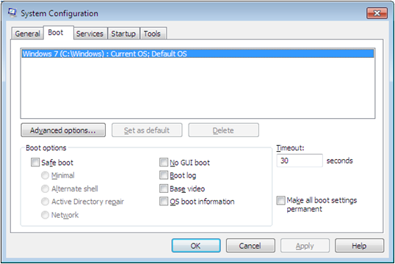
Using the System Configuration Tool
Enables you to exercise a great deal of control over the startup process.
Start, Run, type: msconfig
Notes:
Describe the settings in the System Configuration Tool that can modify the boot process.

Slide 35
Enable Boot Logging
Gathers information about the most recent startup process and saves it to a text file for later examination.
To enable:
  When the POST completes, press the F8 key repeatedly until the Advanced Boot Options menu appears.
  Select Enable Boot Logging
Notes:
Describe the purpose of Boot Logging and how you enable it.

Slide 36
Using Windows RE
Windows Recovery Environment (almost the same as Windows PE but with Recovery Tools)
Allows you to bypass all of the drivers, applications, and services that can be the source of a startup problem
To run: Boot with installation DVD, click Repair Your Computer when prompted
Notes:
Introduce Windows RE.

Slide 37
Using the System Recovery Tools
Startup Repair
System Restore
System Image Recovery
Windows Memory Diagnostic tool
Command Prompt
Notes:
Explain each tool that is available in the System Recovery Tools window.

Slide 38
Using BranchCache
New feature in Windows 7 and Windows Server 2008 R2 that enables networks with computers at remote locations to conserve bandwidth by storing frequently accessed files on local drives.
Notes:
Introduce BranchCache. More details on the following slides.

Slide 39
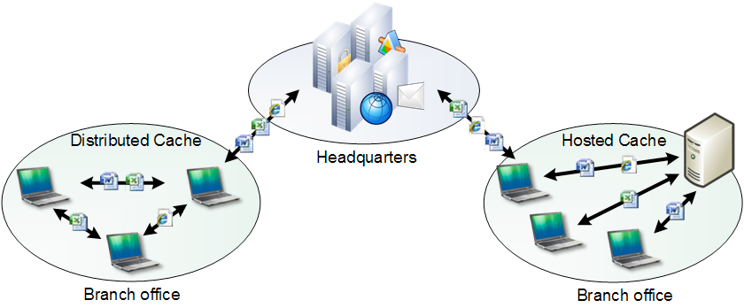
Two Operational Modes
Notes:
Discuss the two operational modes of BranchCache: Distributed Cache Mode and Hosted Cache Mode and the requirements of each.

Slide 40
Using Backup and Restore
Wizard-based
Creates backup of files and folders to a network share, DVD, CD, or other hard disk
Creates a backup of the entire drive using an image-based utility called System Image Backup
Restore files and folders that were previously backed up
Notes:
Introduce the Backup and Restore Program. See the next slide for the fully configured backup, running.

Slide 41
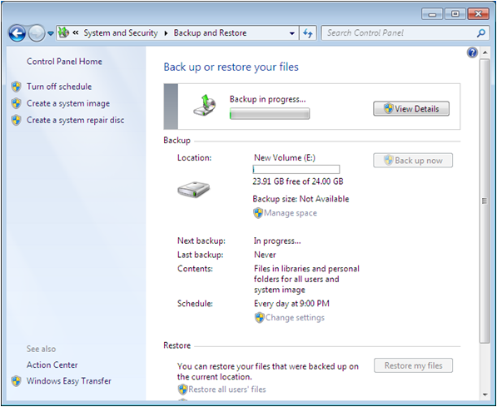
Backup Job Status
Notes:
Review the contents of the screen shot.

Slide 42
Creating a System Image Backup
Creates an image of an entire drive
Saves the information to a virtual hard disk (VHD) on the backup device
Notes:
Describe System Image Backup. Mention that it was called Complete PC in Vista.

Slide 43
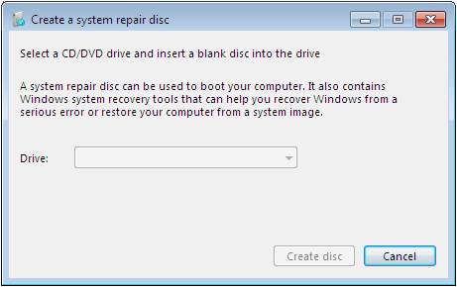
Creating a System Repair Disk
Bootable disk
Contains recovery tools
Notes:
Describe the purpose of a System Repair Disk

Slide 44
Skills Summary
It is important to have a set troubleshooting procedure.
Remote Assistance is a feature that enables an administrator, trainer, or desktop technician at one location to connect to a distant user’s computer.
Remote Desktop is an administrative feature that enables users to access computers from remote locations, with no interaction required at the remote site.
Notes:
Review the Skill Summary to wrap up your lesson.

Slide 45
Skills Summary (cont.)
Windows RE contains a set of troubleshooting tools to repair Windows 7.
BranchCache is a new feature in Windows 7 and Windows Server 2008 R2 that enables networks with computers at remote locations to conserve bandwidth by storing frequently accessed files on local drives.

